Slide 1
IFF Nitro
TECHNOLOGY INTRODUCTION

Slide 2
Primary Purpose of the System
Original Requirement
A measurement system for determining the level of dissolved free nitrogen (N₂) for the purpose of controlling the performance of the degassing system
Selected Method Accurate measurement of O₂, CO₂, and TDGP, from which real-time calculation of the water’s nitrogen saturation will be performed
Conditions
The system must require minimal maintenance – service interval > 3 months
Tolerated deviation < 3%
Assumptions All measured variables must be accurate so that the calculated nitrogen value is correct

Slide 3
Challenges for research, development, and business
a big leap is needed
No reliable third-party measurement of dissolved CO₂ exists on the market
Commercially available TDGP measurement systems are unsuitable – gas-selective and too slow
New technology for measuring CO₂ and TDGP must be developed
The market will need to be convinced of both the accuracy of the new sensors and the correctness of the nitrogen level calculation
Measurements must be completely error-free. Even a small deviation would create a significant problem in subsequent calculations.
So the journey has begun

Slide 4
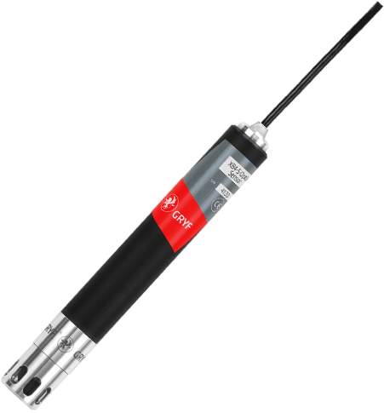
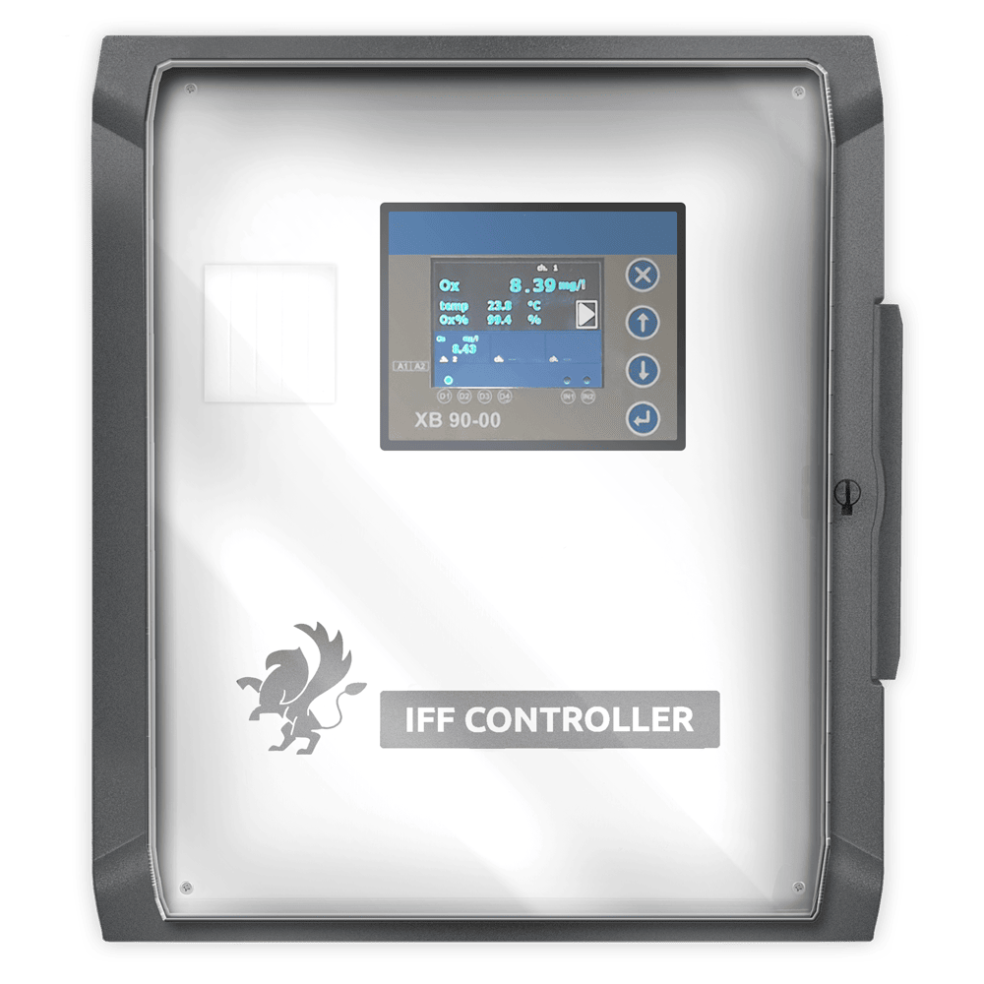
Absolute Accuracy in O₂ Measurement
GRYF XB4-S sensor, automatic compensation of temperature, salinity, and atmospheric pressure
Atmospheric pressure is often overlooked in measurements, but:
Example – Trondheim Typical maximum and minimum pressures throughout the year range from 970 hPa to 1045 hPa. Consider water at 10°C and 35 ppt salinity:
100% saturation at 970 hPa: 7.7 mg/L
100% saturation at 1045 hPa: 8.3 mg/L
Measurement error without pressure compensation: up to 9.3%
GRYF XB90 unit with an integrated atmospheric pressure sensor for real-time compensation
IFF Nitro provides automatic pressure compensation for all measured gases

Slide 5
Accurate Measurement of TDGP
Total Dissolved Gas Pressure
The measurement principle is based on measuring pressure with a sensor separated from the water by a solid membrane.
Most commercially available systems use a microporous polypropylene membrane, which is slow and gas-selective:
In conventional systems, the use of silicone is not possible.
In IFF Nitro, it is possible thanks to a unique membrane system and a measuring chamber with a triple reference architecture.
1 Barrer means that through a material with a surface area of 1 cm² and thickness of 1 cm, 10⁻¹⁰ cm³ of gas passes per second (under standard conditions and with a 1.3 hPa pressure difference between both sides).

Slide 6
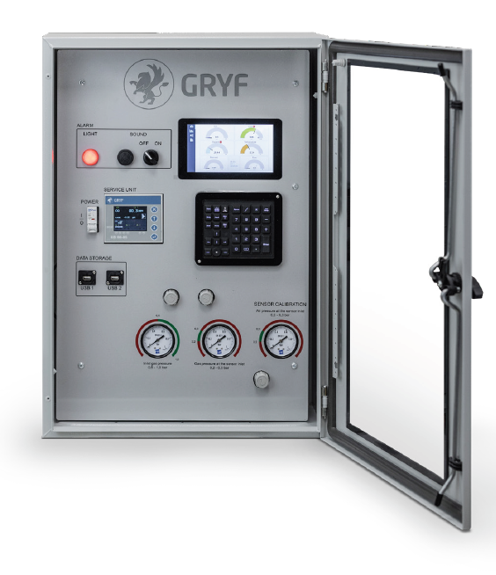
Accurate CO₂ Measurement
A completely new concept for aquaculture, but not for GRYF
The project to develop an immersion sensor at GRYF was concluded in 2022 after three years, with the conclusion that there is no suitable membrane worldwide for this type of application.
Because IFF Nitro sensors operate at an “immersion” of about 5 cm, it was possible to use a highly permeable membrane in combination with a ppm sensor, which GRYF commonly supplies for medical and military applications.
The result is precise and repeatable measurement with an accuracy level previously unseen in aquaculture.
GRYF MGM-23 system for measuring CO, CO₂, and O₂ (military grade).

Slide 7
When simply meeting the requirements isn’t enough
34 years of experience in sensor development in a single, perfect system
The sensor circuit is duplicated: while one is measuring, the other is regenerating and is calibrated against a third set of reference sensors that never come into contact with water.
Protection against biofouling
The water entering the system is biologically deactivated using UV.
During regeneration, the sensor chambers are dried with preheated air mixed with ozone (UV-generated).
During both development and testing of the IFF Nitro system, strict adherence to standards normally reserved for military projects is required

Slide 8
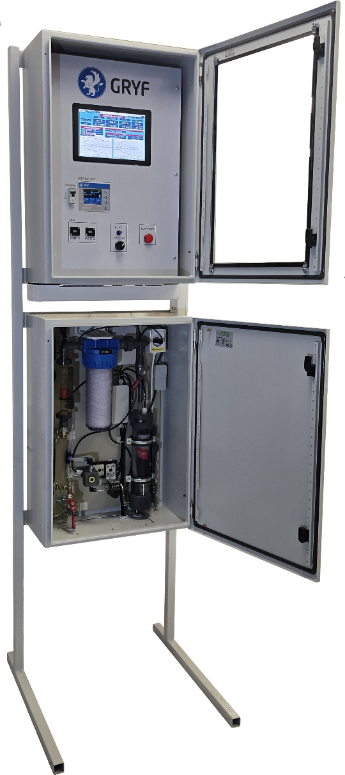
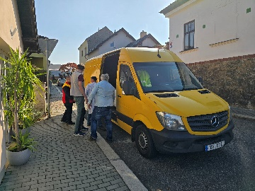
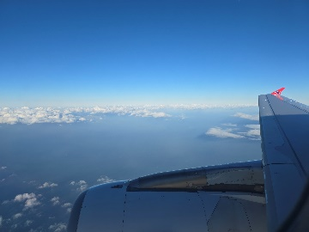
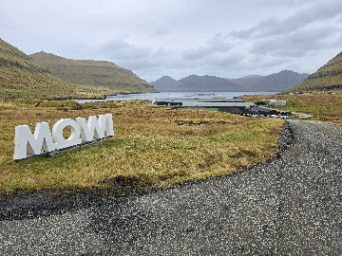
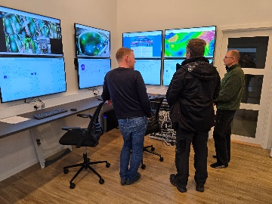
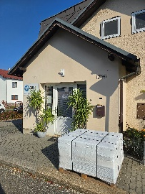
October 2024: Pilot Installation
Production prototype of the IFF Nitro system
Installation took place at the MOWI Hellur salmon farm in the Faroe Islands.
Implementation time: 2 days, including visualization setup in the control center.
Measured parameters: TDGP, O₂, CO₂, N₂, pH, and ORP.

Slide 9
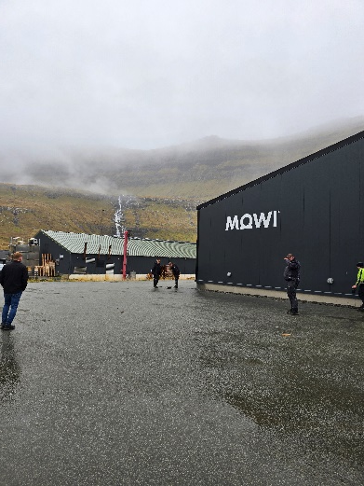
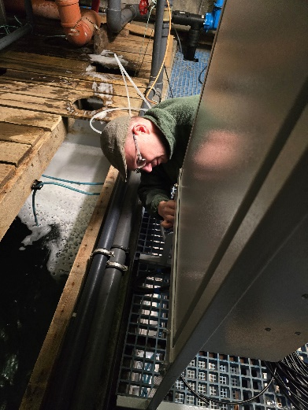
Trial Operation
and Accuracy Evaluation
The system was configured to continuously send data to the cloud.
O₂, TDGP, pH, and ORP measurements could be validated with third-party reference systems.
CO₂ and N₂ measurements could not be independently verified.
An experiment was designed to verify all measurements at once…
UV sanitation was turned off, allowing biologically active water into the system. Based on the dynamics of dissolved nitrogen, the approximate ammonia content is to be calculated

Slide 10
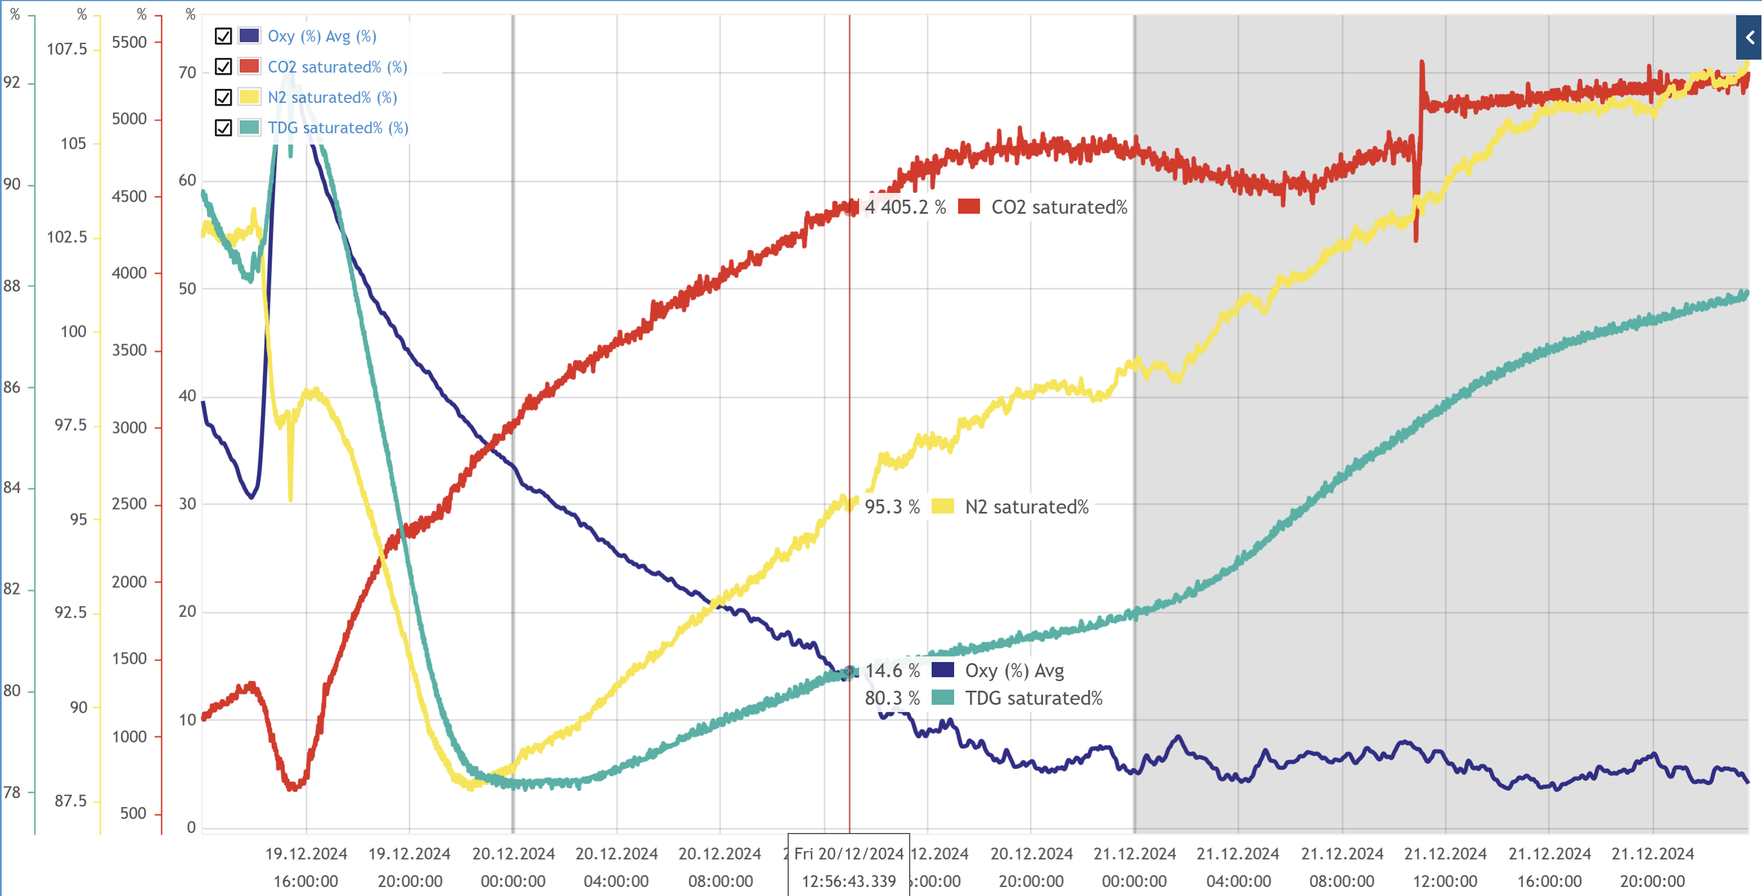
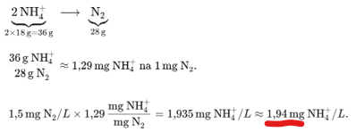
„ Christmas Experiment“
Δ N₂ = 1,5mg/L
Confirming the Accuracy of Measurement
19.12.2024: The measurement loop was sealed with biologically active water inside (including residual ammonia).
After 60 hours, the O₂ level dropped to zero, while the N₂ content increased by 1.5 mg/L and then stabilized.
Using stoichiometric equations, the original ammonia content was calculated (the change in N₂ concentration could only result from biological activity – conversion of ammonia).
Calculated ammonia value: 1.94 mg/L NH₄⁺.
The difference between the calculated and measured ammonia value was 6%.
Customer confirmation
The monitored system was at peak production, and the fish were moved the following day. The biofilter was operating at its limits, and an independently measured ammonia value was 1.83 mg/L NH₄⁺.

Slide 11
Evaluation of the Experiment
What Can Be Further Improved?
The ammonia experiment was repeated under laboratory conditions. It was found that the 6% deviation was caused by disregarding the presence of ammonia in the calculation of N₂ from TDGP, O₂, and CO₂.
If ammonia had been correctly accounted for, the calculated nitrogen value would have been lower—thus the subsequent calculation of ammonia concentration would have shown a difference of less than 1% from the measured value.
It can therefore be stated:
The measurement of TDGP, CO₂, and O₂ exceeded expectations and fully met the requirements.
The calculated N₂ value is within tolerance. However, to achieve complete accuracy, ammonia content should be included in the calculation, as elevated ammonia can skew the results.
The experiment demonstrated that the applied sensor regeneration/sanitation methods reduce the impact of biofouling to an unnoticeable level.

Slide 12
Conclusion of the Trial Operation
System Released for Commercial Use
IFF Nitro provides an unprecedented level of accuracy in measuring TDGP, O₂, and CO₂, which enables it to deliver a highly accurate value of dissolved nitrogen.
Any potential deviation in the event of elevated ammonia concentrations is insignificant in the context of the intended application. However, the commercial system already allows for compensating this factor through an input from an external sensor.
IFF Nitro System Capabilities
Smooth control of degassing system performance → reduction in electrical power consumption
Meaningful dosing of oxygen → reduction in energy use relative to results achieved
Control of water recirculation level in an RAS system → optimization of environmental impact

Slide 13
Acknowledgements
LEIF MOHR – Andrias Joensen
Inspiration for the development of the IFF Nitro system, R&D consultation, implementation support
MOWI – Michael Mikkelsen
Implementation support, collaboration in evaluating the pilot operation
CzechTrade Agency (Chile branch) – Dipl. Ing. Jiří Jílek
Whose Chilean team helped us with market analysis and confirmed interest in the product from Chilean partners
GRYF – Dipl. Ing. Marek Míša and team
Project manager, system architect
Salmon
Whose farming continually presents us with new and ongoing challenges

