Slide 1
Oxygen Retention Supersaturation
Technology introduction

Slide 2
Technology Transfer and Consolidation
Oxygen Management, Energy, Measurement, and Automation
Oxygen distribution through water supersaturation has been used in RAS systems since the 1970s.
Advanced measurement and control methods enable the transfer of this technology to wastewater treatment plants (WWTPs).
The technological process includes oxygen concentration (PSA), which inherently allows for its accumulation.
Oxygen accumulation enables efficient utilization of fluctuations in electricity production (renewable sources).
The result is an increase in WWTP capacity (supersaturation technology) and a reduction in energy costs (through accumulation), among other benefits.

Slide 3
Understanding Oxygen Consumption in the Biofilter
Optimal Oxygen Concentration at Different Stages
Stage of Biofilter | Chemical Transformation | Bacterial Strains | Optimal DO Saturation | Share of Total Oxygen Consumption
1. Aerobic Phase (Nitrification) | NH₃ → NO₂⁻ → NO₃⁻ | Nitrosomonas, Nitrobacter | 2–6 mg/L | 55–60 %
2. Anoxic Phase (Denitrification) | NO₃⁻ → NO₂⁻ → NO → N₂O → N₂ | Paracoccus, Pseudomonas | 0,1-0,3 mg/L | 10-15%
3. Anaerobic Phase (Phosphorus Removal) | Release and subsequent binding of phosphates (PO₄³⁻) | Acinetobacter | 0,2-0,5 mg/L | 5-10%
4. Polishing (Water Purification) | Removal of residual organic matter and particles | Aerobic bacteria (various) | 1–4 mg/L | 15-20%

Slide 4
Oxygen Distribution Methods
From the Perspective of Current Practice
 | Bubble Aeration | Supersaturated Water
Typical Application | Biofilters in WWTPs | Biofilters in RAS
Oxygen Transfer Efficiency | 3–6% per 1m water column | Up to 100% when targeting sat. <50% DO
Oxygen Storage | Not possible | Oxygen storage in pressurized tanks
Precision of Dosing | Low, oxygen transfer from bubbles is significantly influenced by water chemistry | High, oxygen is supplied in already dissolved form
Maintenance Requirements | High: Requires cleaning/replacement of aeration elements | Low: Oxygen is carried by pressurized water (jet injection)
With fine-bubble, clean diffusers placed at a depth of 5m, the "cost" of delivering 1kg of O₂ to activated sludge is 1.2–1.4 kWh (under ideal conditions).
For supersaturated water, depth is irrelevant, energy consumption is 1.1–1.3 kWh per 1kg O₂.

Slide 5
Benefits of Proper Oxygen Dosing
Utilizing Supersaturation Technology
Higher WWTP capacity without the need for structural modifications.
Reduced maintenance costs for the oxygen distribution system.
More efficient energy use.
Potential for energy storage utilization (Oxygen production for storage).
Reduction of undesirable metabolites → higher methane purity.

Slide 6
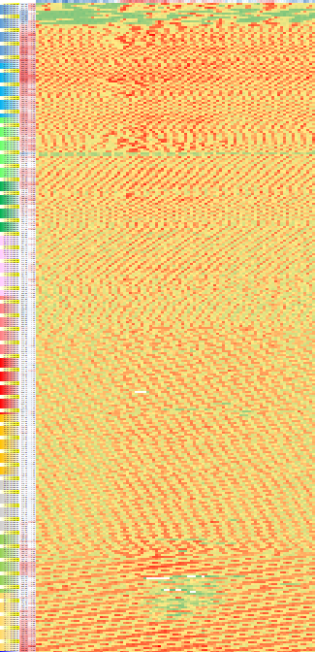
Annual Electricity Consumption Profile in WWTPs
Oxygen Regulation via Bubble Aeration Has No Potential for Utilizing Surplus from Uncontrolled PV Systems
2024
New PV system at WWTP covers consumption in spring–autumn only around noon
2024
Uncontrolled, unused PV system surplus
2024
Negative spot electricity prices due to PV overproduction across Europe
2024
Unutilized surplus must be paid for (blue)
2023
WWTP electricity consumption distribution without PV system
Potential of Oxygen Retention Supersaturation Technology
Full utilization of PV surplus - Preparation and storage of oxygen for dosing in the evening, at night, and in the morning
1 year
24 hours
Highest
Medium
Lowest
None
Negative

Slide 7
Utilization of PV Energy Storage for On-Site Oxygen Production
Oxygen can be used also in sludge treatment processes
2024
Surplus from On-Site PV System
2024
Optimization of Existing Consumption
2024
Trends in European Spot Prices
Oxygen concentrator (PSA)
Utilizes on-site or the cheapest available electricity
Morning and evening price peaks= energy shortage in the grid
O₂
Nighttime and midday price drops = energy surplus in the grid
1 year
Oxygen dosing from storage
Allows the WWTP to avoid purchasing electricity during morning and evening peaks
24 hodin

Slide 8
Technology Benefits
Transition to Supersaturation Technology in Combination with Energy Dispatching
Immediate WWTP capacity increase by 15–20%: Implications for urban planning possibilities.
Reduction in energy consumption by 5–15% (depending on specific conditions).
Utilization of surplus energy from renewable sources. (Further reduction of electricity costs, estimated at 20–30%).
Water management accounts for 2–3% of total energy consumption in the EU. Wastewater treatment: 1–2% of annual consumption (28–56 TWh).
For comparison: The Dukovany nuclear power plant generated 14.3 TWh in 2020.
*) Sources: EUREAU (European Federation of National Water Services), EEA (European Environment Agency), JRC (Joint Research Centre)

Slide 9
Conclusion
The amount of oxygen consumed is determined by bacteria.
Our goal is to ensure they do not also control energy management.

